Slide 1
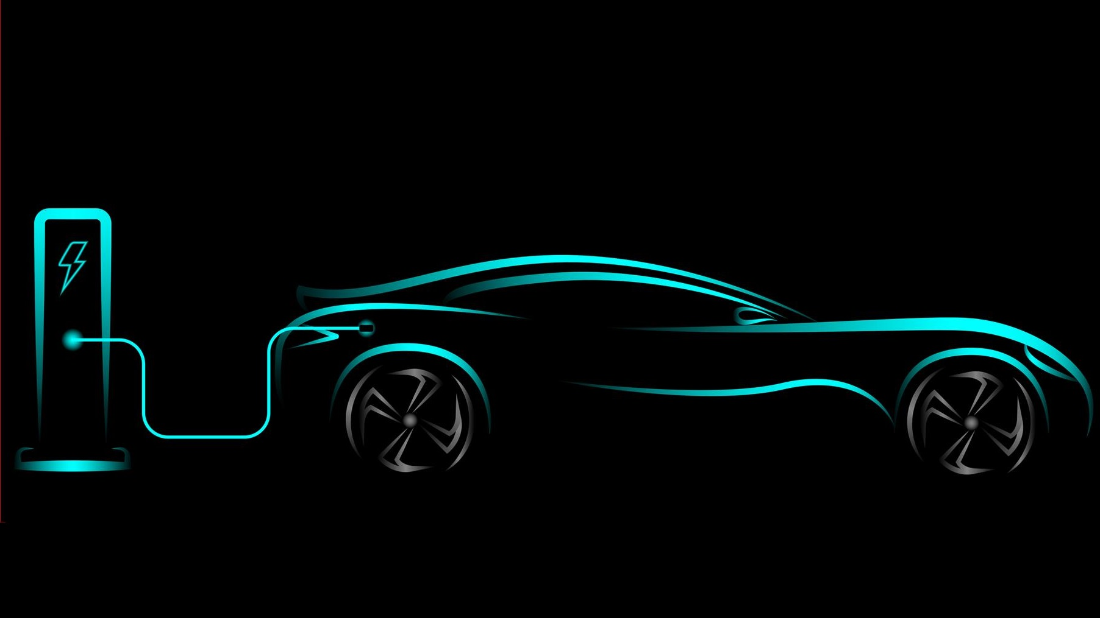
EV Market Analysis
By
Jameer Ahamad Syed
August 1, 2024

Slide 2
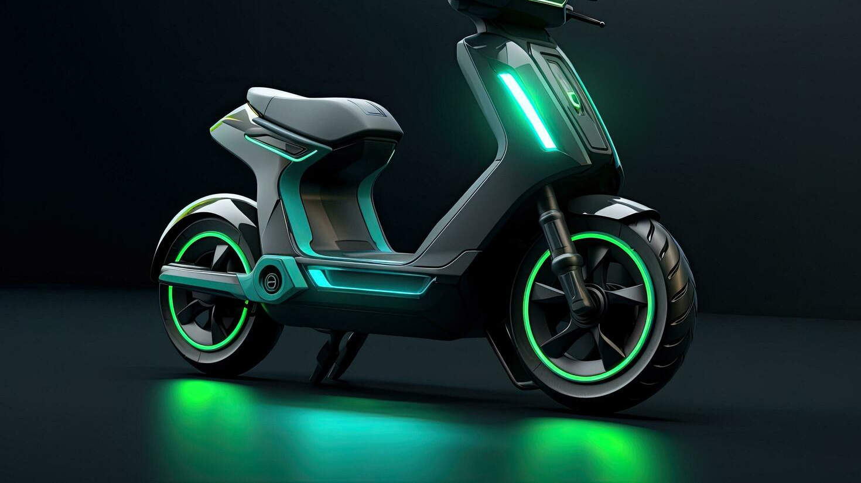
Problem Statement
AtliQ Motors is an automotive giant from the USA specializing in electric vehicles (EV). In the last 5 years, their market share rose to 25% in electric and hybrid vehicles segment in North America. As a part of their expansion plans, they wanted to launch their bestselling models in India where their market share is less than 2%. Bruce Haryali, the chief of AtliQ Motors India wanted to do a detailed market study of existing EV/Hybrid market in India before proceeding further.

Slide 3
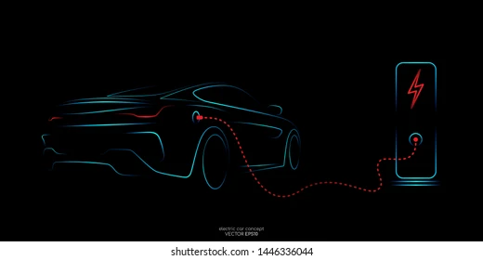
Objective
The aim of this market study is to analyze the overall trends and growth of the EV and hybrid vehicle market in India. We will review relevant regulations and incentives impacting the automotive sector. Based on this analysis, we will develop strategic recommendations to assist AtliQ Motors in planning their entry and expansion into the Indian market.

Slide 4
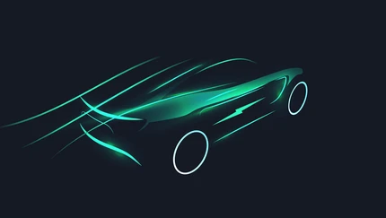
Data Overview
Dim_date
Electric_vehicle_sales_by_maker
Electric_vehicle_sales_by_state

Slide 5

Methodology

Slide 6
Key Insights of Electric Vehicle (EV) in India
Sales Insights
Geographical & Market Insights

Slide 7
Sales Insights

Slide 8


Slide 9
Geographical & Market Insights

Slide 11

Insights
Market Growth Potential: The EV and hybrid vehicle market in India is experiencing rapid growth, driven by increasing environmental awareness and government incentives for sustainable transportation. Despite a lower market share, there is significant potential for expansion.
Regulatory Support: The Indian government offers various incentives, subsidies, and policy support for EVs and hybrids, including reduced GST rates, subsidies under the Faster Adoption and Manufacturing of Hybrid and Electric Vehicles (FAME) scheme, and state-specific policies.

Slide 12
Insights
3. Consumer Trends: Growing urbanization and an increase in disposable income are leading to higher adoption rates of EVs and hybrids in metropolitan areas. There is a rising preference for energy-efficient and eco-friendly vehicles among urban consumers.
4. Infrastructure Development: The development of EV charging infrastructure is accelerating, with both public and private investments aimed at expanding the network across key urban and semi-urban areas.
5. Challenges and Opportunities: Key challenges include the high cost of EVs and limited charging infrastructure. However, these challenges present opportunities for innovative solutions and partnerships to enhance market penetration and consumer adoption.

Slide 13

Conclusion
The Indian EV market shows strong growth potential with supportive policies and rising consumer interest. Despite some challenges, expanding AtliQ Motors’ EV branch into India is a promising opportunity for capturing a significant market share and driving future success.

